Slide 1
ENTERPRISE DATA RECONCILIATION & BUSINESS INTELLIGENCE
GLOBALTECH FINANCIAL AUDIT PIPELINE
INTERNSHIP STUDIO PROJECT
Presented by: Maitreyini S
Tools: Python, SQL, Pandas, Regular Expressions, Power BI

Slide 2
PROJECT OVERVIEW
Objective
• Combine user, transaction, server log and exchange rate data.
• Identify the latest status of users.
• Clean and extract valid transactions from server logs.
• Reconcile transaction data with daily EUR to USD exchange rates.
• Calculate USD revenue and prepare the final BI dataset.
Project Details
• Audit period: January–December 2023
• Database: SQLite
• Processing: Python, Pandas and Regular Expressions
• Output: Power BI-ready CSV dataset

Slide 3
DATA SOURCES
Source Files
• Enterprise Database — user information, status and update date.
• Server Logs — transaction date, User ID, Product ID and Euro value.
• Daily Exchange Rates — EUR to USD conversion rates.
• Final Power BI Dataset — reconciled transaction data.
Final Dataset
• 53,899 reconciled records
• Date
• User ID
• Product ID
• Euro Value
• EUR to USD
• USD Revenue
• name

Slide 4
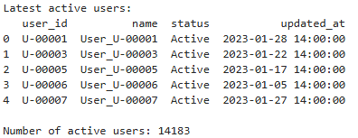
PHASE 1 – SQL USER STATUS EXTRACTION
Objective
• Identify the latest status of each user.
• Keep only users whose latest status is Active.
CODE
SELECT user_id, name, status, updated_at FROM ( SELECT user_id, name, status, updated_at, ROW_NUMBER() OVER ( PARTITION BY user_id ORDER BY updated_at DESC ) AS rn FROM users ) WHERE rn = 1 AND status = 'Active';
SQL Method
• ROW_NUMBER() with PARTITION BY user_id
• ORDER BY updated_at DESC
• rn = 1 and status = 'Active'
Result: 14,183 Active Users

Slide 5

PHASE 2 – SERVER LOG PROCESSING
Process
• Load the server log file.
• Remove ERROR transaction records.
• Use Regular Expressions to extract transaction fields.
• Convert Date and Euro_Value to usable data types.
• Remove incomplete records.
CODE
with open(log_path, "r", encoding="utf-8") as file:
raw_logs = file.readlines()
pattern = re.compile(...)
Validation Results
• Raw logs: 100,000 | ERROR removed: 5,098 | Clean transactions: 94,902

Slide 6
PHASE 3 – EXCHANGE RATE RECONCILIATION
Process
• Load the daily EUR to USD exchange rate file.
• Convert Date to datetime and sort by date.
• Forward-fill missing exchange rate values.
• Merge transactions with FX rates on Date.
• Calculate USD Revenue.
CODE
fx["Date"] = pd.to_datetime(fx["Date"])
fx["EUR_to_USD"] = pd.to_numeric(
fx["EUR_to_USD"],
errors="coerce"
)
fx = fx.sort_values("Date").reset_index(drop=True)
fx["EUR_to_USD"] = fx["EUR_to_USD"].ffill()
print("Missing FX values:", fx["EUR_to_USD"].isna().sum())
USD_Revenue = Euro_Value × EUR_to_USD
Validation: Missing FX values after reconciliation = 0

Slide 7
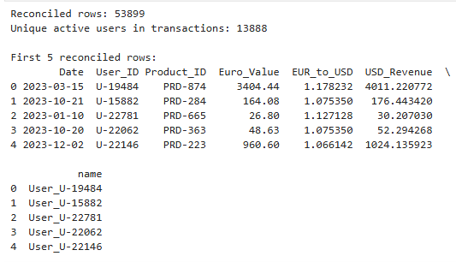
PHASE 3 – ACTIVE USER RECONCILIATION
Process
• Merge cleaned transactions with the active user list.
• Match transactions using User_ID.
• Retain only transactions belonging to active users.
• Calculate final USD revenue.
• Validate the final dataset.
CODE
merged = transactions.merge(
fx[["Date", "EUR_to_USD"]],
on="Date",
how="left")
merged["USD_Revenue"] = (
merged["Euro_Value"] *
merged["EUR_to_USD"])
display(merged.head())
final_data = merged.merge(
active_users[["user_id", "name"]],
left_on="User_ID",
right_on="user_id",
how="inner")
final_data = final_data.drop(
columns=["user_id"])
print("Reconciled rows:", len(final_data))
53,899 reconciled rows | 0 missing FX | 0 missing USD revenue

Slide 8
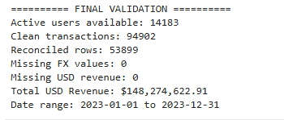
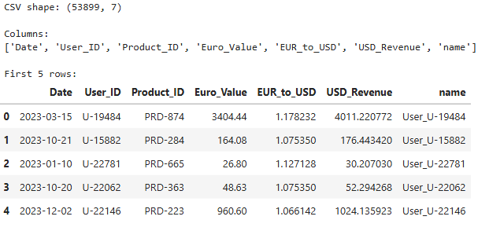
FINAL DATASET & VALIDATION
Exported File
•power_bi_ready_dataset.csv
• 53,899 rows exported
• Date range: 2023-01-01 to 2023-12-31
Total USD Revenue: $148,274,622.91

Slide 9
PHASE 1–3 PROCESS FLOW
Enterprise Database
Phase 1: SQL User Status Extraction
14,183 Active Users
Phase 2: Server Log Cleaning & Regex Parsing
94,902 Clean Transactions
Phase 3: FX Reconciliation & Active User Matching
53,899 Reconciled Transactions
USD Revenue Calculation
$148.27 Million Total USD Revenue
Power BI-Ready Dataset

Slide 10
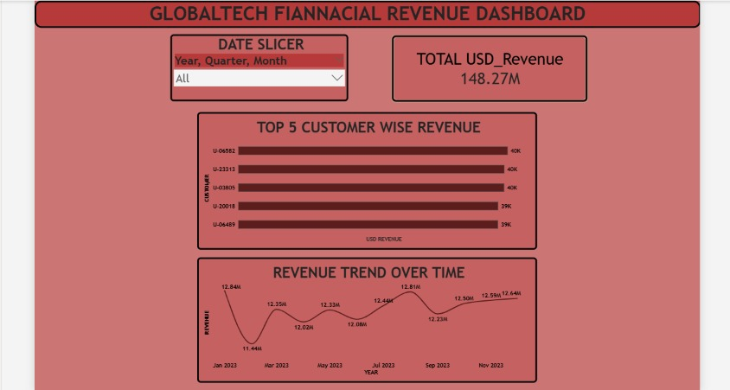
PHASE 4 – POWER BI DASHBOARD
Required Components
• Date Slicer | Total USD Revenue | Revenue Trend Over Time | Top 5 Customers by Revenue

Slide 11
PROJECT OUTCOME
Completed Work
• Extracted latest active user records using SQL.
• Cleaned and parsed 100,000 server log transactions.
• Removed 5,098 ERROR records.
• Prepared 94,902 valid transactions.
• Reconciled transactions with daily exchange rates.
Final Results
• Matched transactions with active users.
• Generated 53,899 final reconciled records.
• Calculated total USD revenue of $148,274,622.91.
• Exported the final dataset for Power BI.

Slide 12
CONCLUSION
Summary
• The project completed the data reconciliation process from raw enterprise data to a Power BI-ready dataset.
• SQL was used to identify the latest active users.
• Python and Regular Expressions were used to clean and extract transaction information.
• Exchange rates were used to calculate USD revenue.
• Active-user reconciliation produced 53,899 records with no missing FX or USD revenue.
• The final CSV was prepared for Power BI reporting with dashboard.

